Slide 1


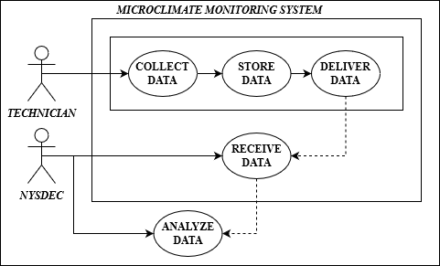

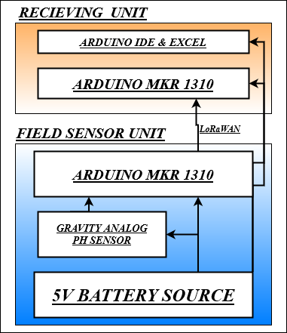
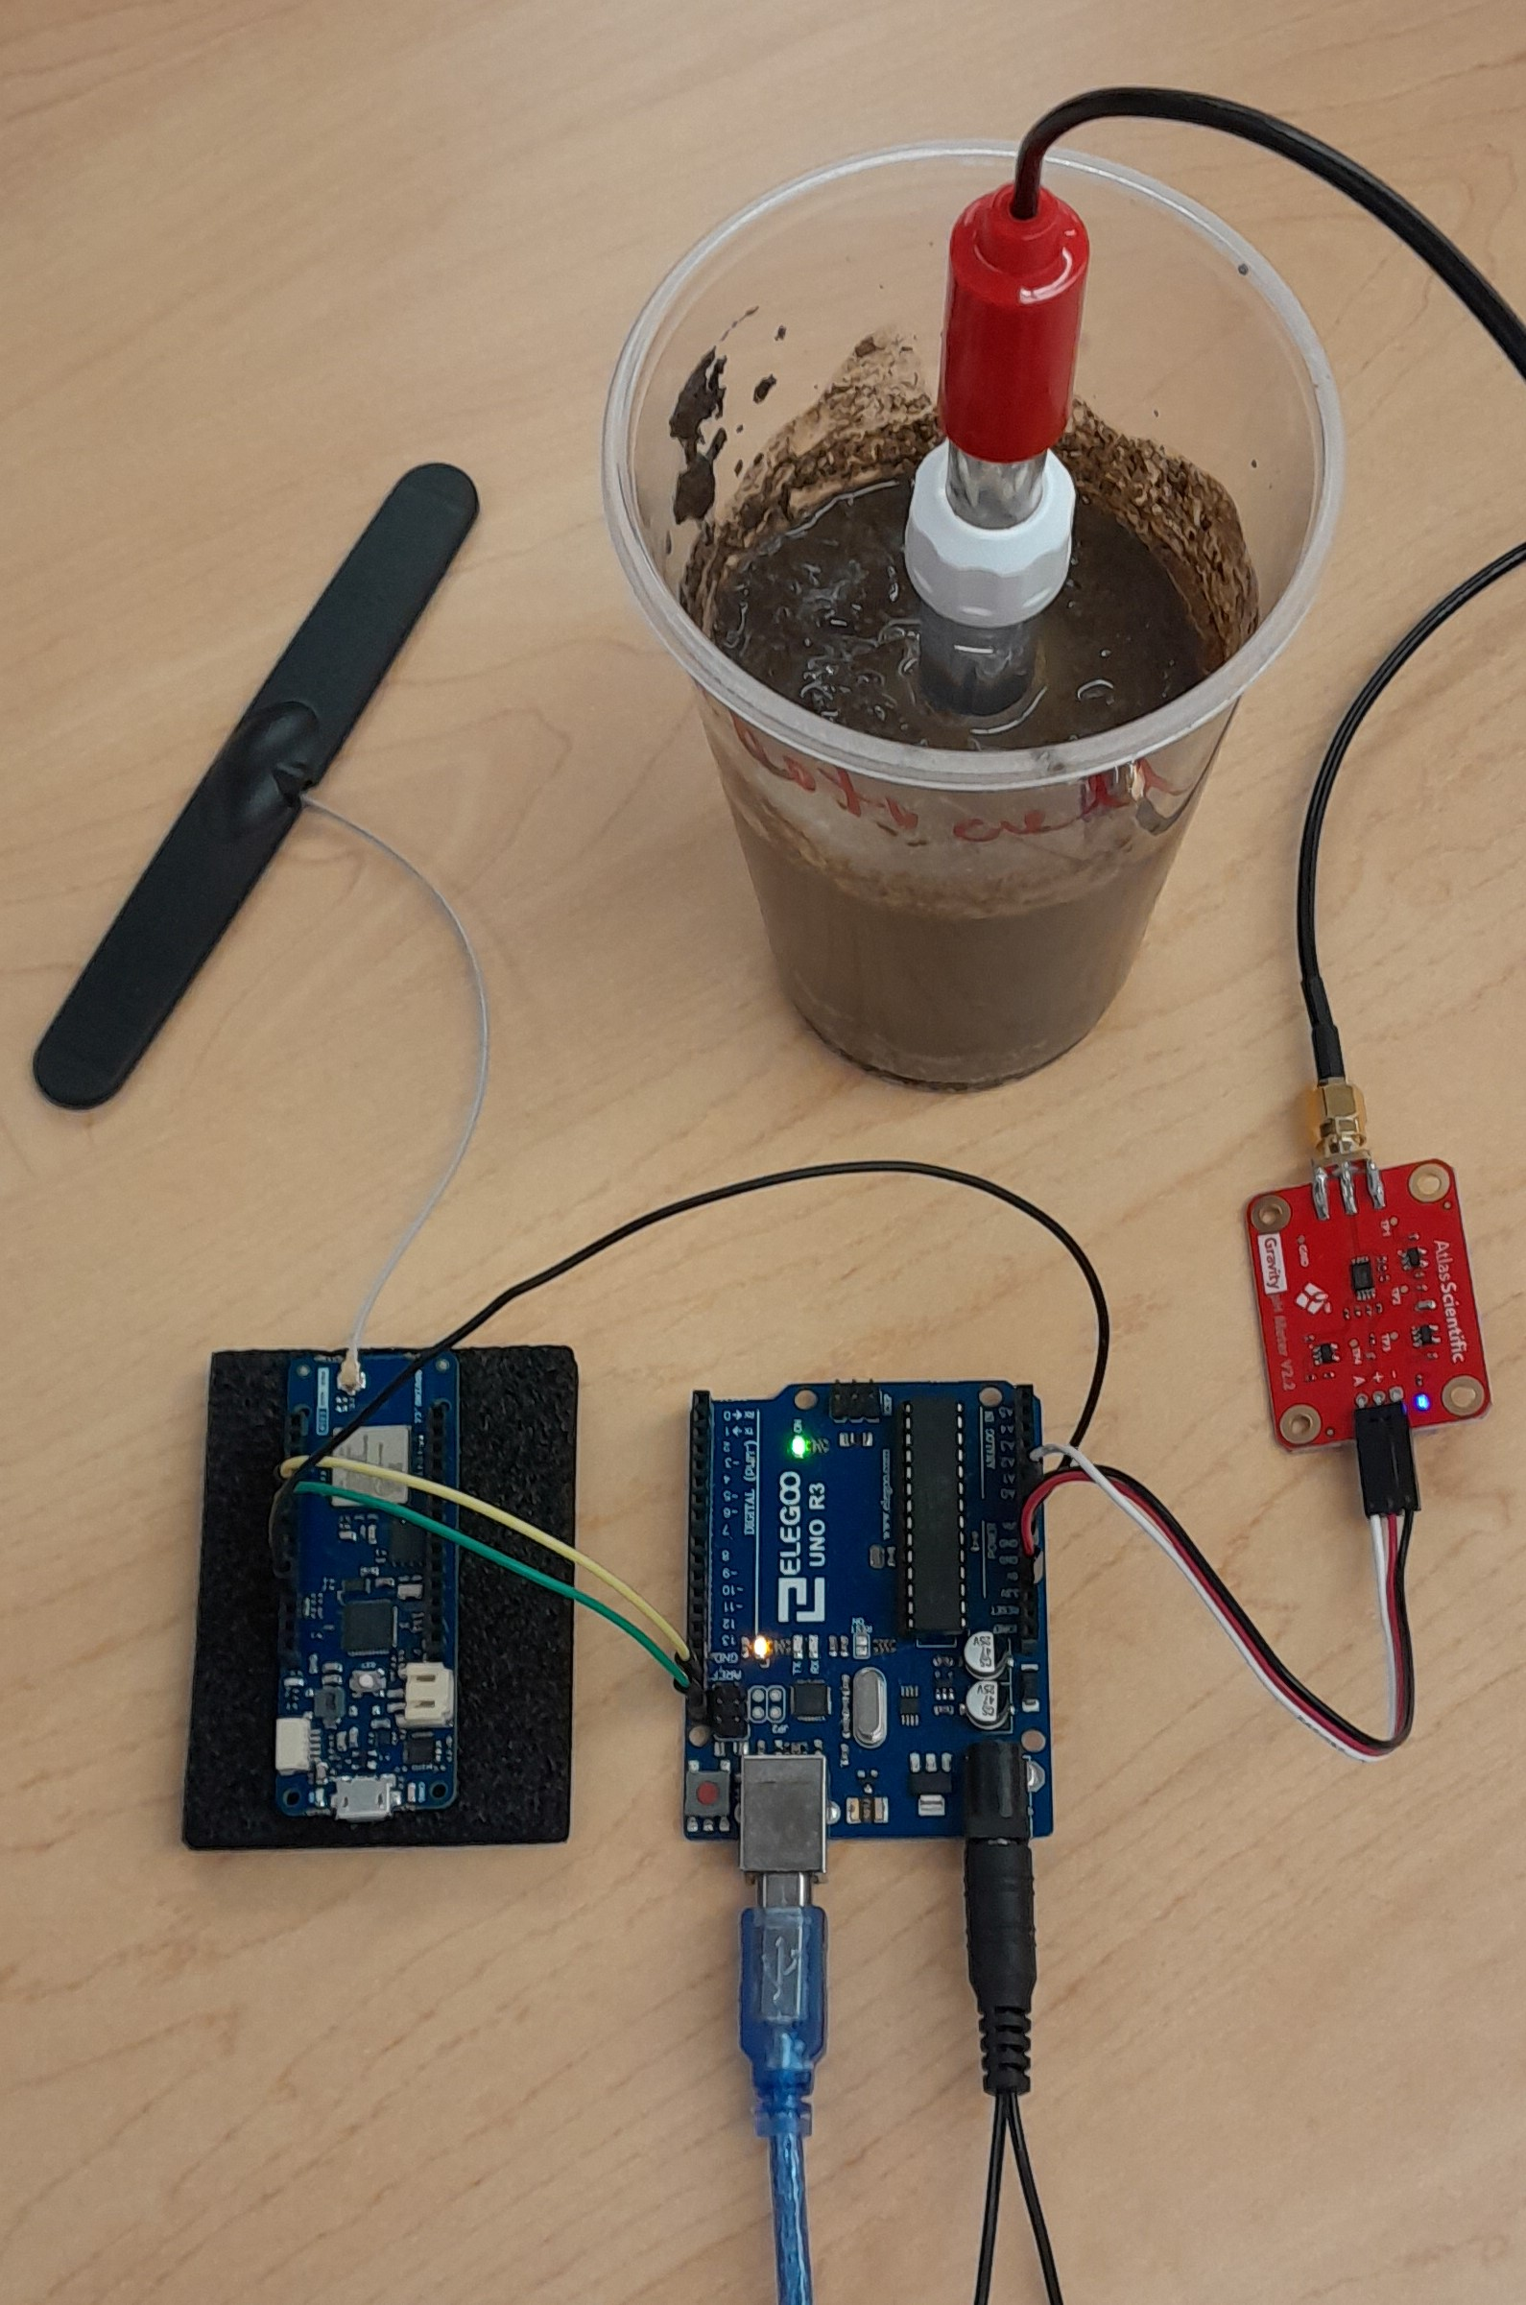
Microclimate Soil Monitoring System Shakib Ahmed, Jeremy Allen, David Kiszka, and Alex Pilkey Department of Electrical & Computer Engineering, University at Albany
Problem Statement
System Design
System Design
The New York State Department of Environmental Conservation (NYSDEC) needs a better understanding of the possible impact of global changes in the climate on the microclimates within New York State so that appropriate plans may be developed to both take advantage of the positive effects and mitigate any adverse effects.
Key System Features
To satisfy system requirements, we incorporated the following design specifications:
Arduino MKR 1310: Two devices are used - one in the field unit to store and transmit the data and the other connected to the technician's computer to receive the data from the field unit.
Arduino Uno R3: Device to control the field unit operations, including the sensor input.
Gravity Analog pH sensor: pH sensor designed to be placed into soil and send pH levels to transmission device.
System Requirements
Environmental Sensing: The system will be collecting pH readings from a sensor placed in the ground.
Collect Data: The pH readings will be collected four times per day.
Store Data: The data collected from the pH sensor will be stored on the devise until a technician retrieves it.
Deliver Data: The primary data collection method will be wireless via a command from the technician once they are within range.
Receive Data : The technician will visit the site monthly to collect the data to their computer.
Analyze Data: The data that has been collected will be checked for corruption, stored into a data file, and delivered to the NYSDEC.
Use Case Diagram
Technician: Collects the stored data from the field unit, organizes it into a data file, and delivers the data to the NYSDEC.
NYSDEC: Receives the data file from the technician and analyzes and incorporates the data into a larger microclimate picture, which is made available to the public.
Left: Dipole Antena with MKR WAN-1310 transmitter.
Top & Right: PH sensor connected to pH meter placed in soil.
Center: Arduino Uno R3 used for control MKR devices.
Physical Design
Bill of Materials
Part | Purpose | Cost
Gravity Analog pH Kit | Sensor to test pH levels in soil | $85.85
Arduino MKR 1310 | Send pH sensor data | $50.07
Arduino MKR 1310 | Receive pH sensor data | $50.07
Arduino R3 Uno | Read pH sensor data and control field unit operations | $34.99
Dipole Antena | Sending/Receiving signal | $5.99
Housing | Field unit housing | $9.99
TOTAL | TOTAL | $236.96
Project Partners
Soil pH sensor with transmission device

